Slide 1

Stock Compounders drive markets
Andrew Latto, CFA – www.fundhunter.co
CFA UK Webinar – 26 June 2019

Slide 2
Disclaimer
Past performance is not a reliable indicator of future results

Slide 3
The long-term investment problem
1) Maximise return
2) Keep risk of large & permanent loss ≈ zero
Performance is all that matters

Slide 4
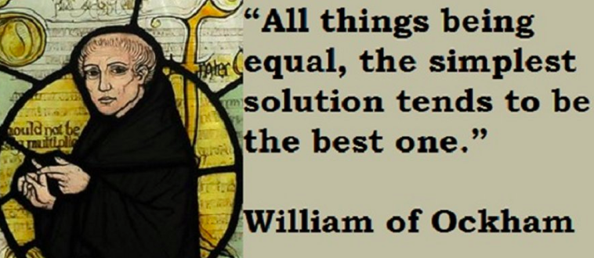
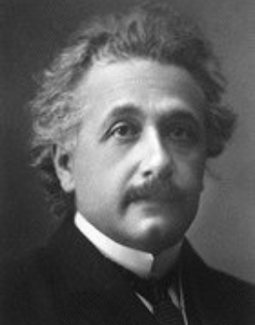
Problem solving
Ockham’s razor
Albert Einstein
Everything should be made as simple as possible, but not simpler

Slide 5
Reducing risk
1) Diversify to reduce impact of blow-ups (funds)
2) Own quality to reduce the number of blow-ups
3) Be valuation conscious

Slide 6
Max. returns: Compounding through reinvestment
Einstein – Eight wonder of the world. Those who understand it receive it. Those who don’t pay it.
Terry Smith – Unique advantage of equities - reinvestment at a high rate of return (April 17).

Slide 7
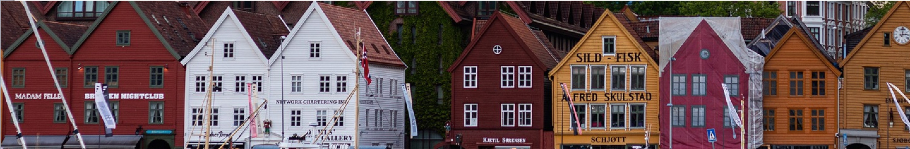
Bessiminder – Do stocks outperform Treasury Bills?
Data on 25,332 US stocks (all CRSP) from 1926 to 2016
22 out of 23 stocks (24,240, 95.7%) collectively matched the return of 1-month Treasury Bills
1 out of 23 stocks (1,092, 4.3%) responsible for market’s
outperformance against 1-month Treasury Bills.
1 out of 281 (90, 0.36%) stocks responsible for the majority of the market’s outperformance

Slide 8
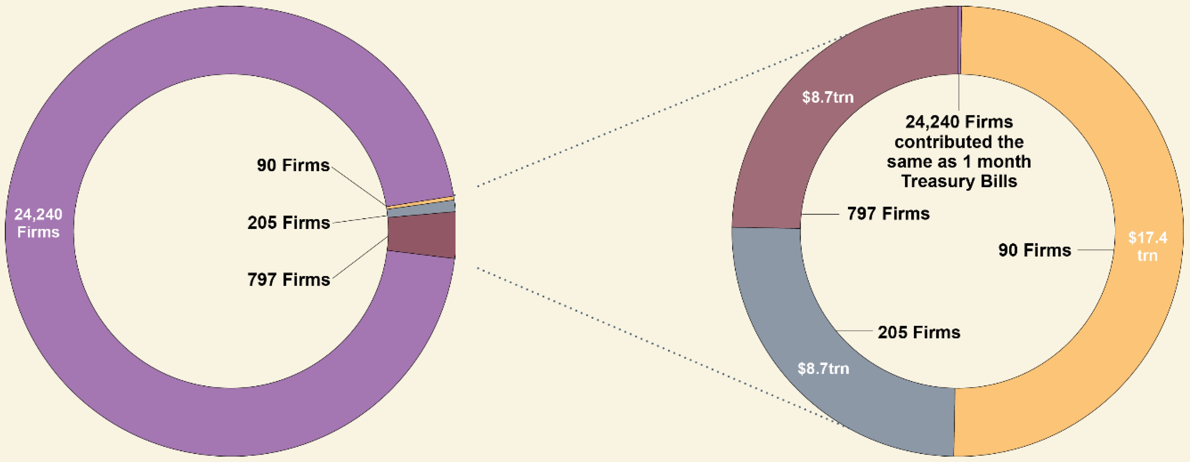
Wealth created by US listed common stocks 1926-2016
The orange slice drives the majority of mkt outperformance
Source: Bessiminder, Baillie Gifford, 25,332 US stocks in total (1,092 drive the market’s outperformance)

Slide 9
Investing implications
Equity investors need to own the scarce winners
1) Passive funds – Will contain the winners
2) Active funds – Need to own winners (styles)

Slide 10
Passive investing options
Own the world equity market
Select markets/sectors with a high concentration of winners

Slide 11
Active - investing in winners
Invest in current winners (Unilever, Facebook)
Invest in competitive winners that are set to be financial winners (Amazon, Salesforce)
Invest in potential winners (early-stage firms)

Slide 12
Active investing – avoiding blow-ups
Long-established firms
Sector/demand/disruption/balance sheet
Ownership structure

Slide 13
Types of stock
Stock Compounders - rare, a few drive markets
Mediocre stocks – low returns and/or low growth
Blow-up stocks – need to avoid i.e. Connaught
Styles: A) Rebounders (value) B) Compounders (quality)

Slide 14
Stock valuation
1) A company is valued in-line with its ability to
generate free cash flow (DCF)
Other valuation approaches (low PE, high growth) are simplistic and misleading

Slide 15
Stock compounders: durable businesses that
Generate high returns on invested capital in cash
Sustain high returns (moats)
3) Realize high-return growth (organic)
= Free cash flow per share growth

Slide 16

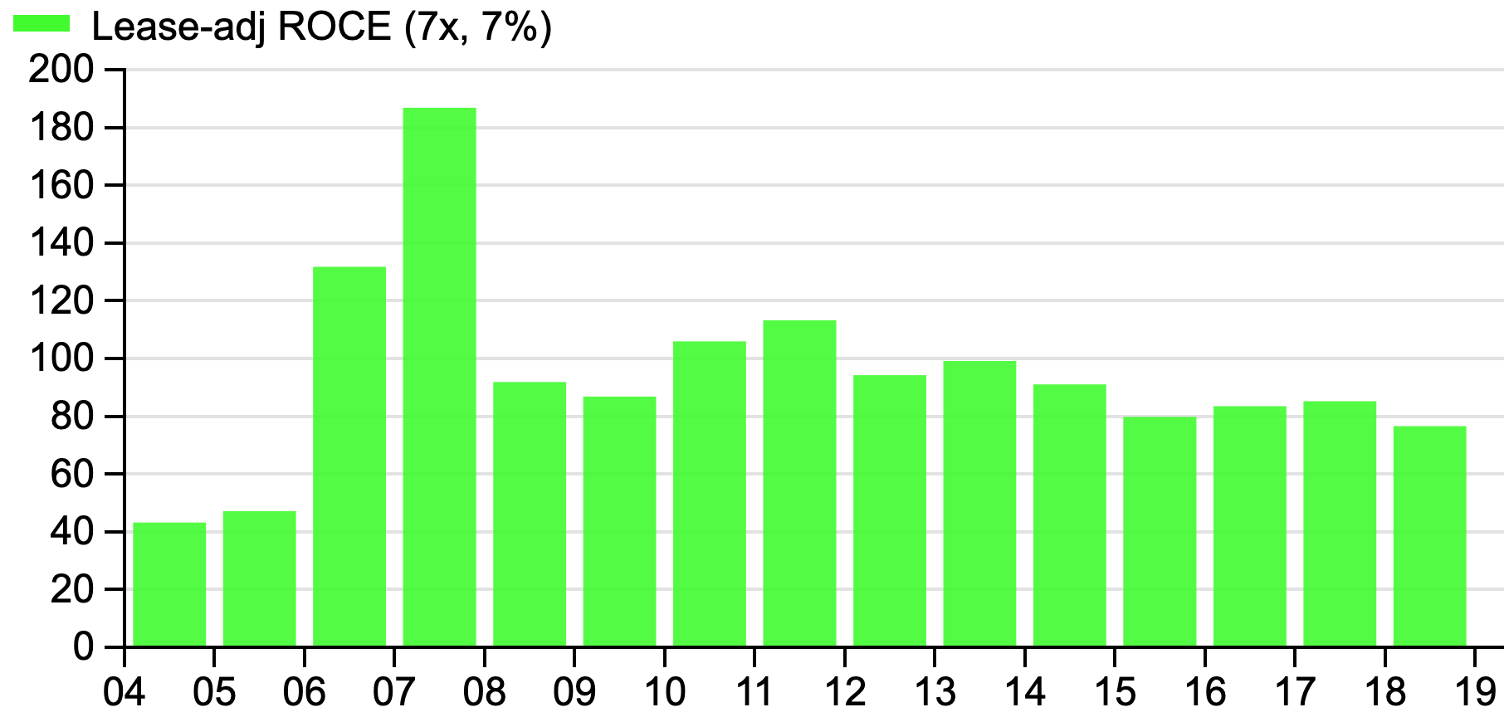
1) Generate a high Returns on Capital Employed
2) Sustain high returns
=

Slide 17
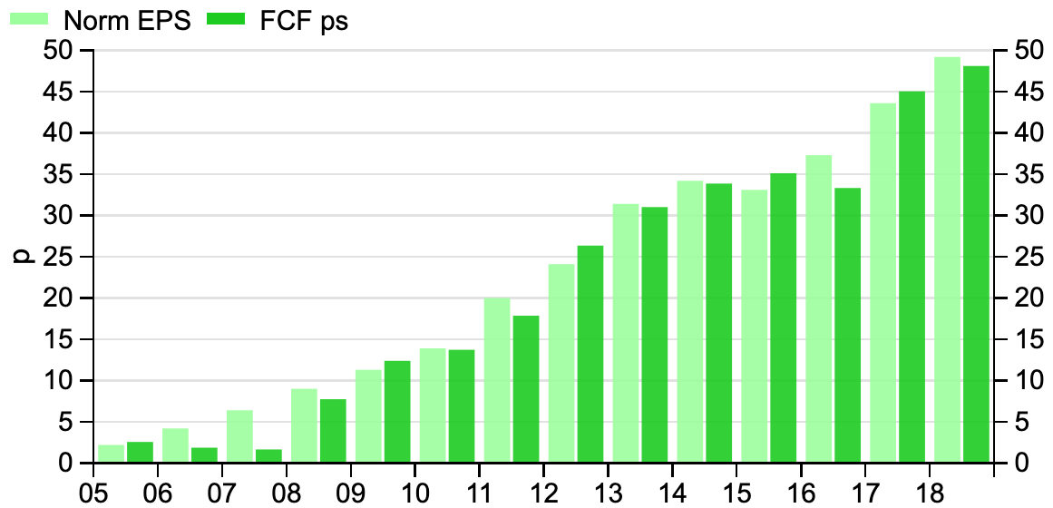
3) Realize high-return growth

Slide 18
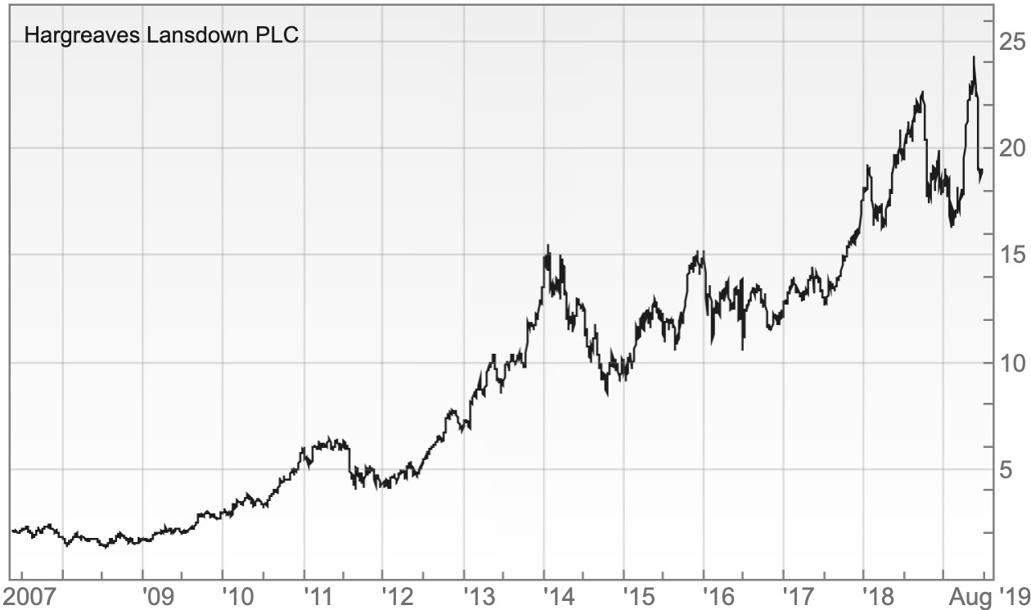
The shares compound in value

Slide 19

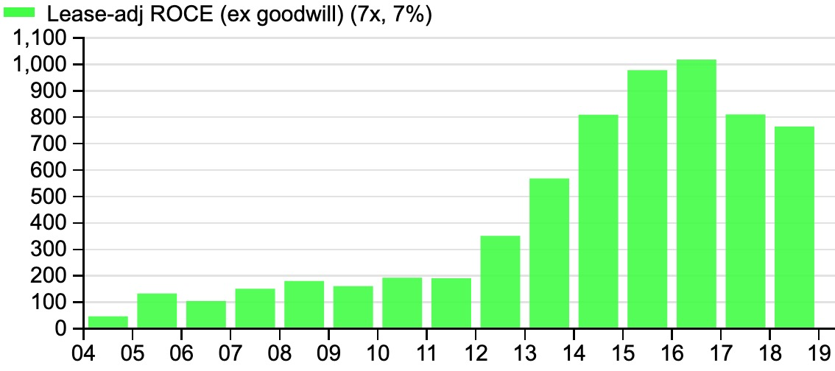
Highest return FTSE All-Share company

Slide 20
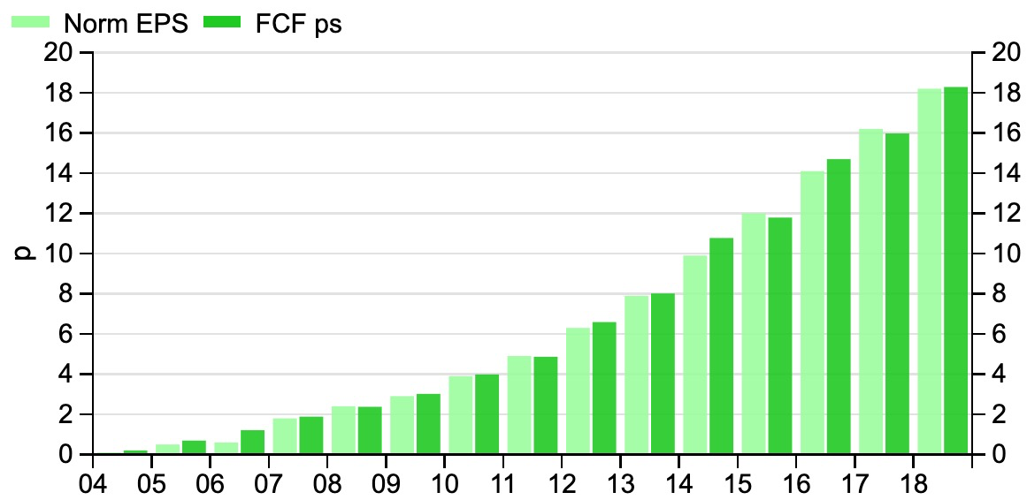
Earnings per share and free cash flow per share

Slide 21
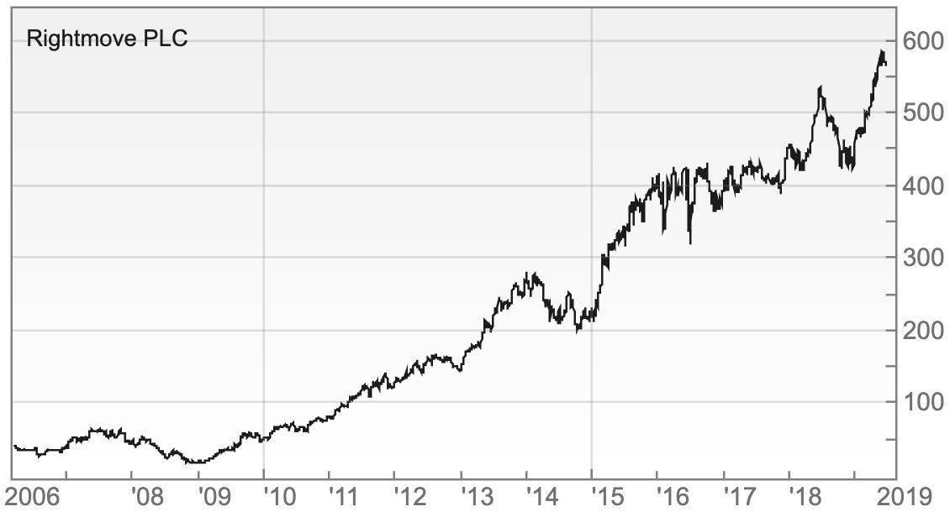
The shares have moved in line with FCF per share

Slide 22
Stock compounders
Benjamin Graham’s returns and GEICO (cigar butts)
2) Asset allocation: National markets, small companies
versus large companies, emerging markets
3) Sectors: Staples, IT, Health care versus materials etc

Slide 23
Fund Hunter approach: passive & active
Objective – identify funds with stock compounders & few mediocre/blow-up stocks
2) How – Learn how the best active funds invest
3) Analyze stocks - to better understand funds

Slide 24
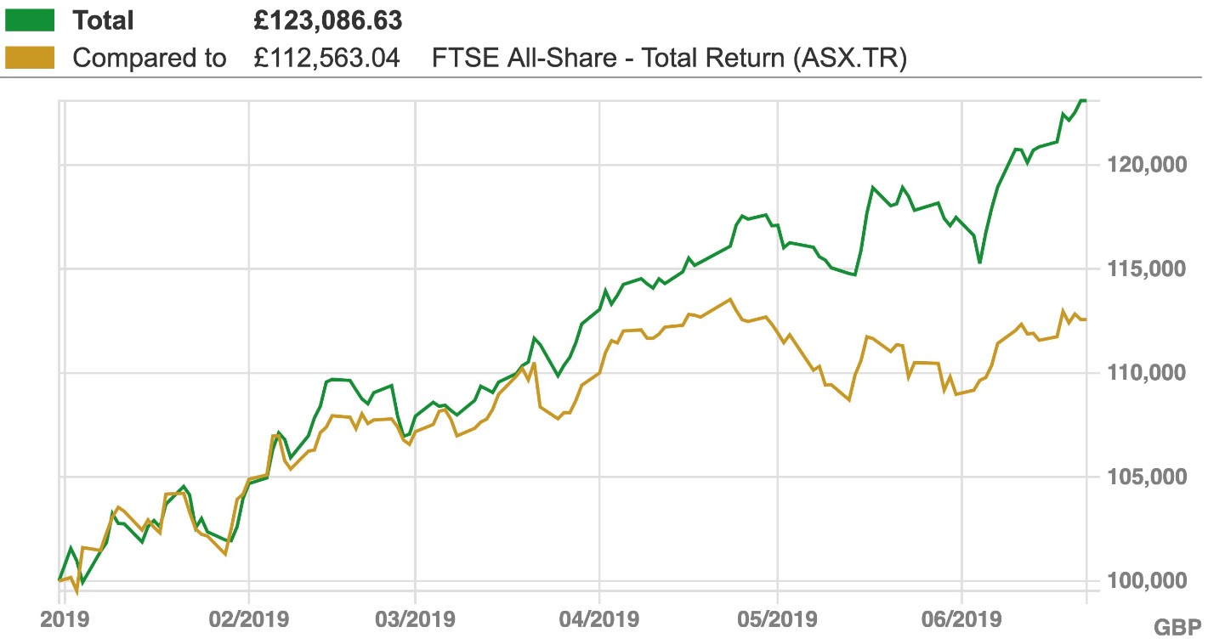
FH Model fund portfolio against UK All-Share

Slide 25
www.fundhunter.co
Thank you!

